Slide 1

Plotting Data with Seaborn
Marcelo Leomil Zoccoler
With material from
Robert Haase, BiAPoL, PoL TU Dresden
September 2022

Slide 2
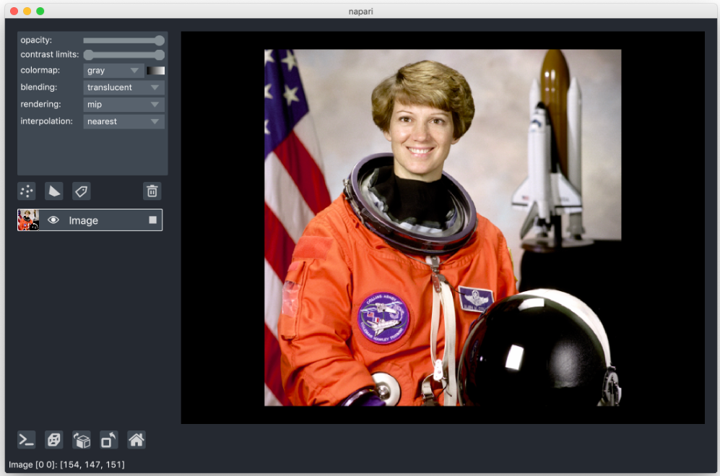
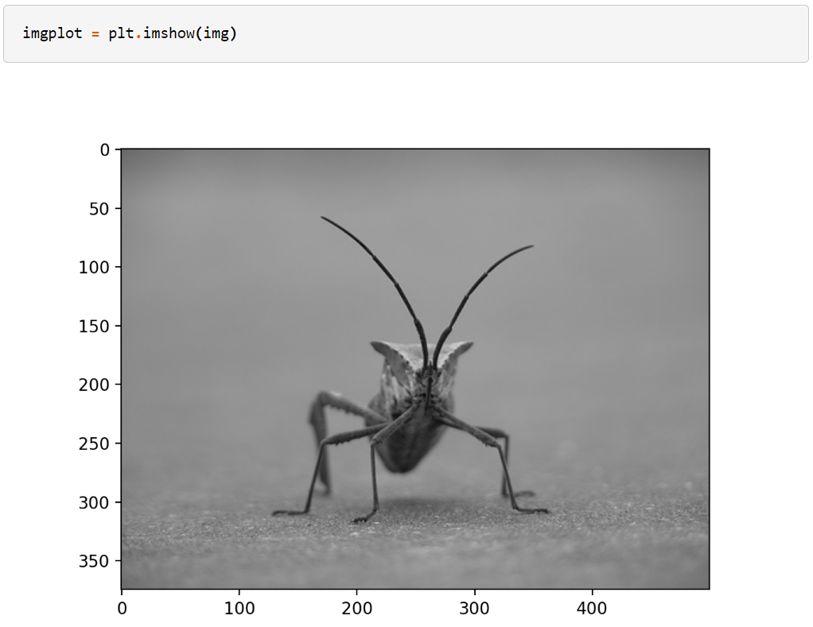
Plotting Data with Python
Displaying images
napari
matplotlib

Slide 3
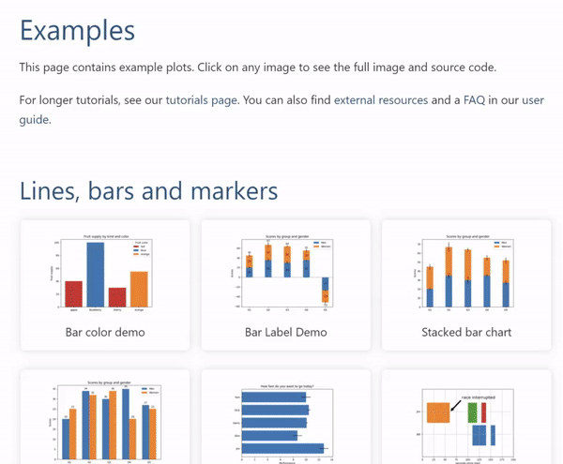
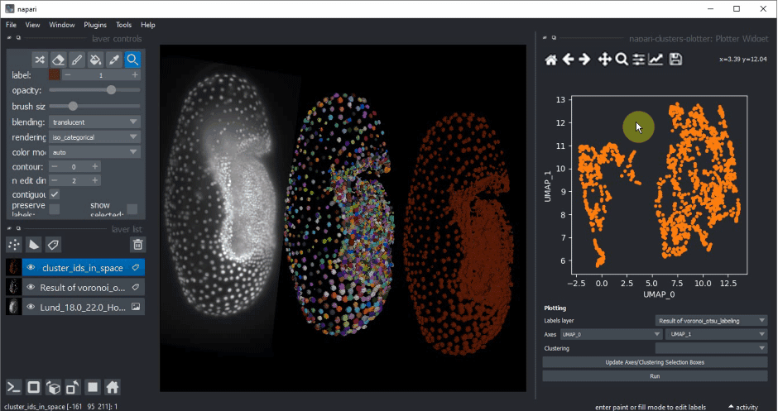
Plotting Data with Python
Displaying graphs
napari
matplotlib
https://github.com/BiAPoL/napari-clusters-plotter

Slide 4
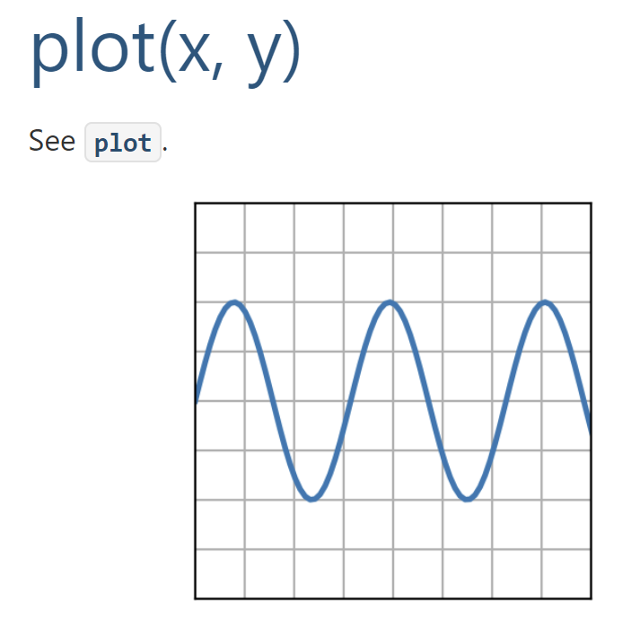
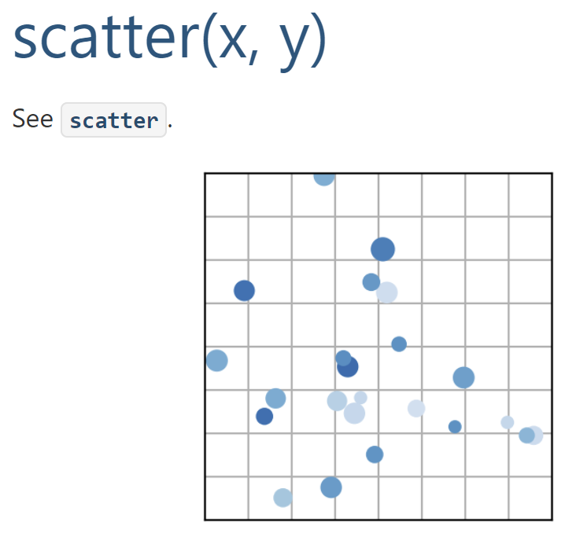
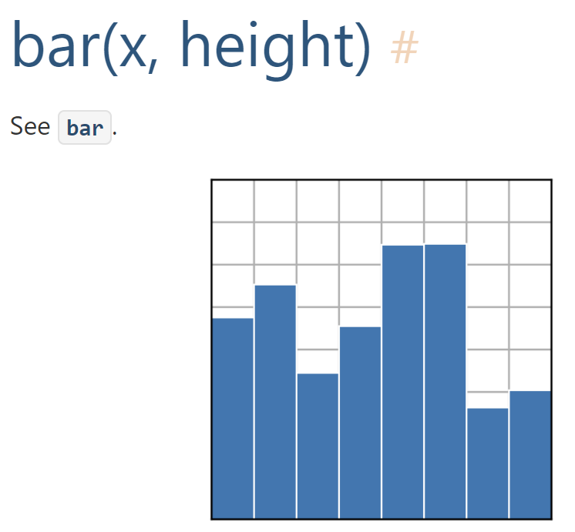
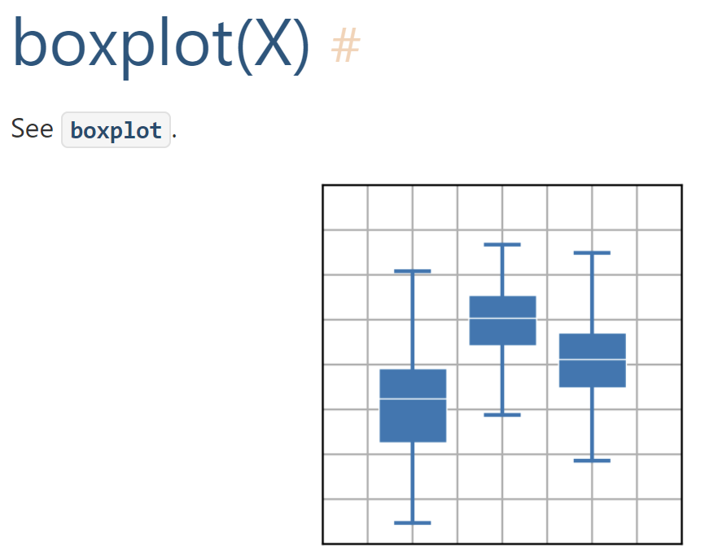
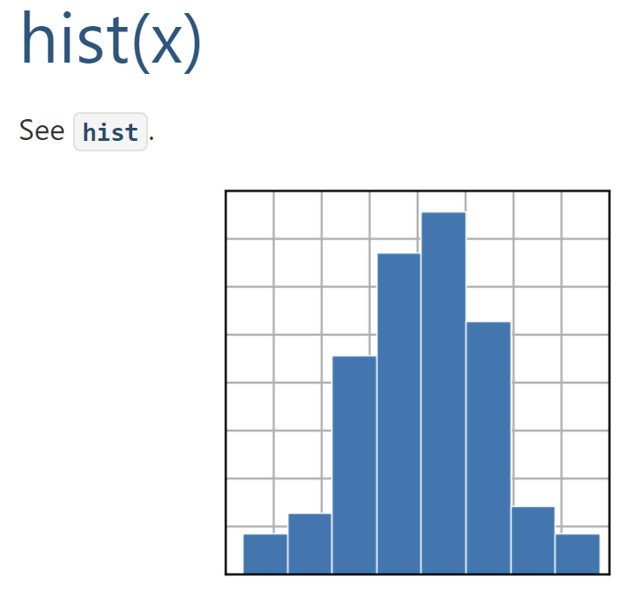
Plotting Data with Matplotlib
Basic Plot Types
Statistical Plots

Slide 5
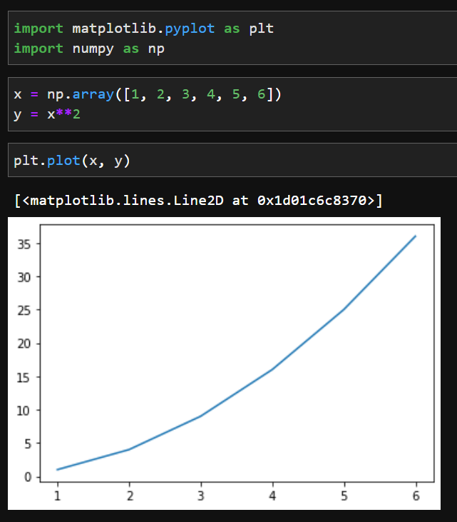
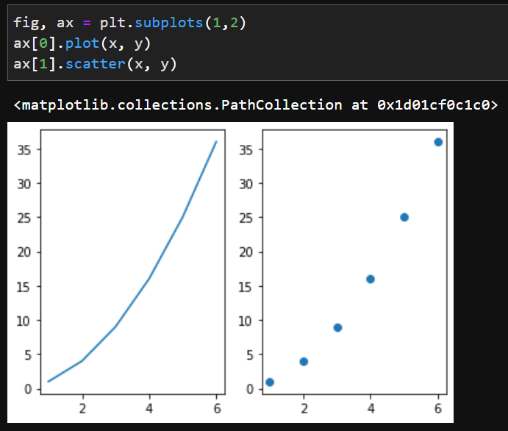
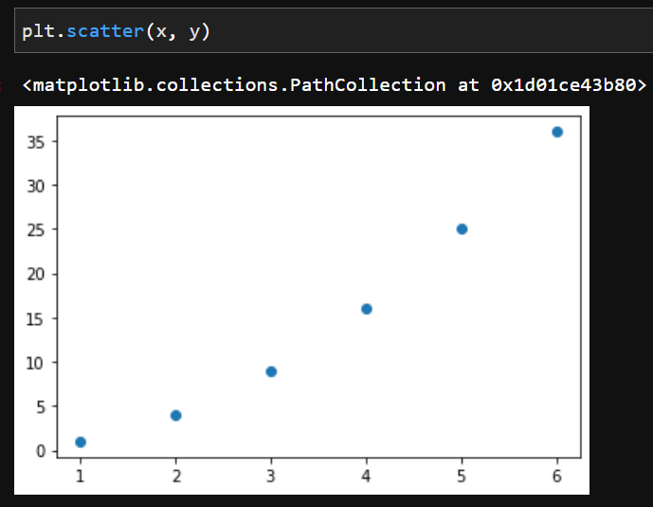
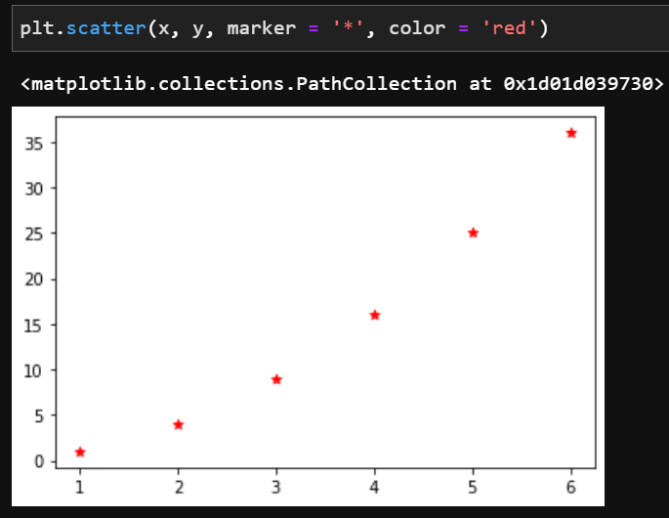
Plotting Data with Matplotlib
Individual plots:
Plots with subplots:

Slide 6
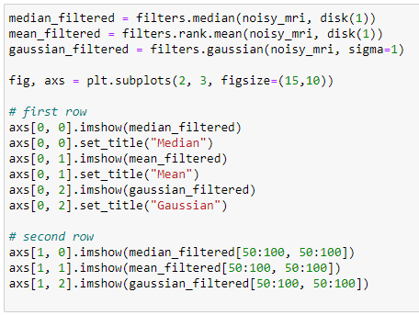
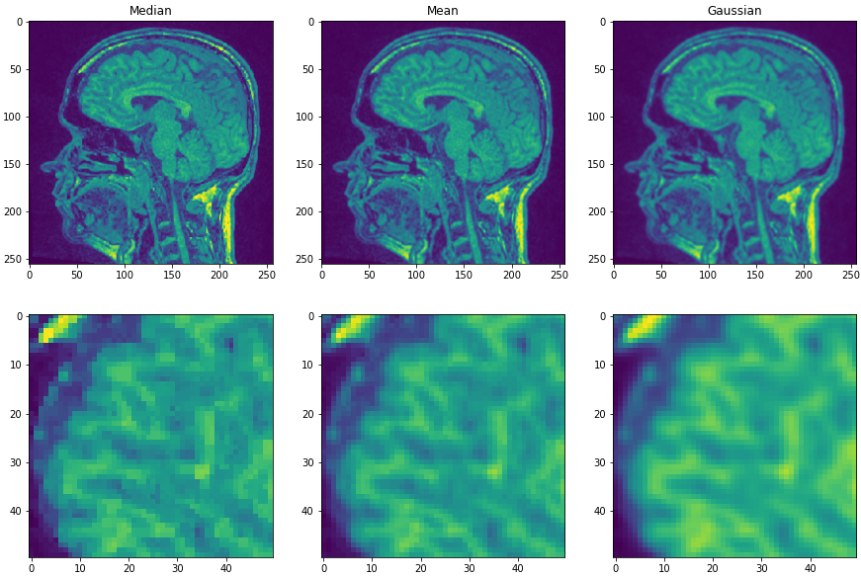
Plotting Data with Matplotlib
rows
columns
row
column
https://matplotlib.org/stable/api/_as_gen/matplotlib.pyplot.subplots.html

Slide 7
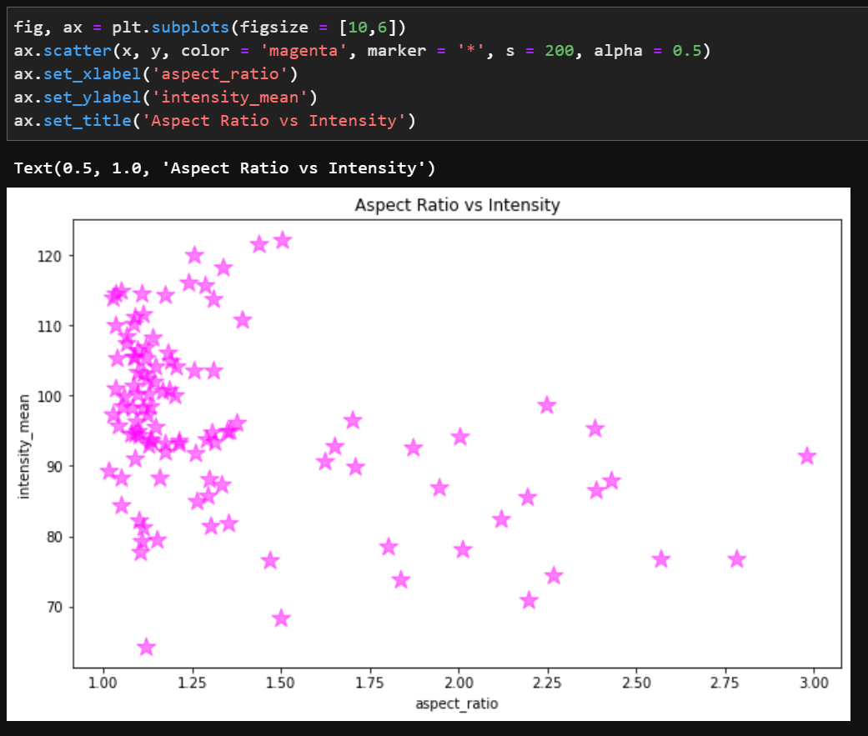
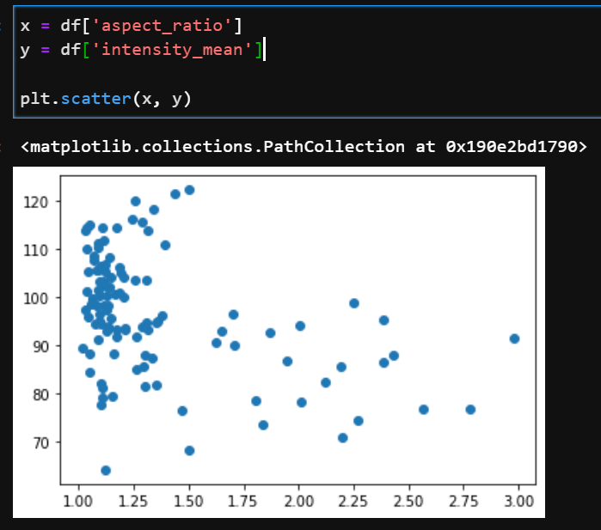
Plotting Data with Matplotlib
Plotting tabular data:

Slide 8

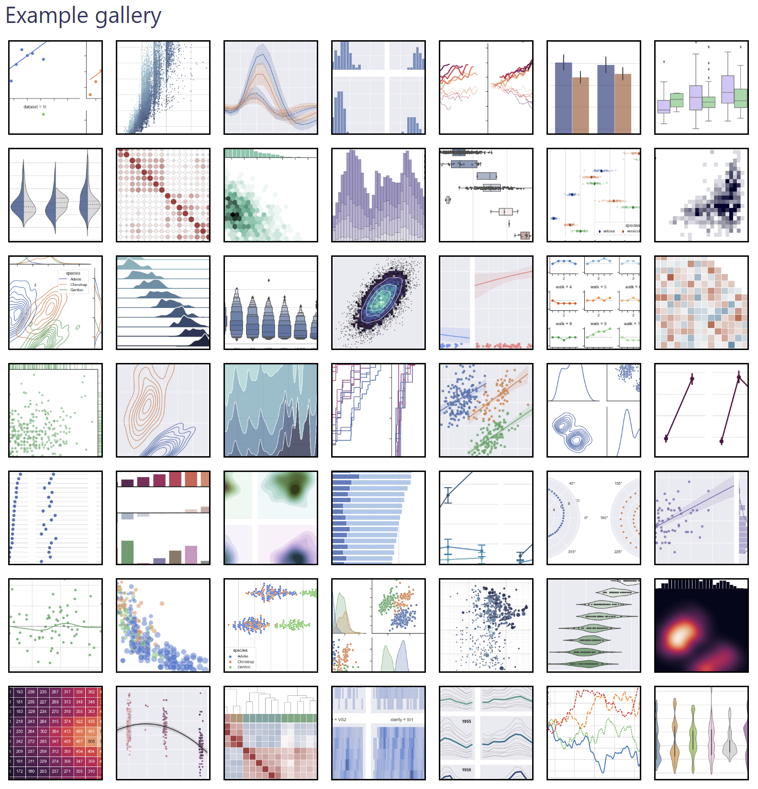
Plotting Data with Seaborn
https://seaborn.pydata.org/tutorial/introduction.html
https://seaborn.pydata.org/examples/index.html

Slide 9
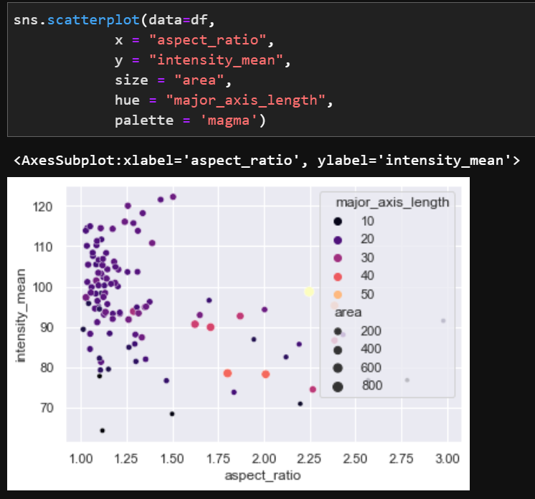
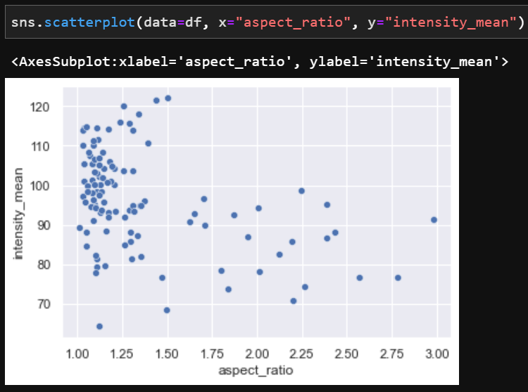
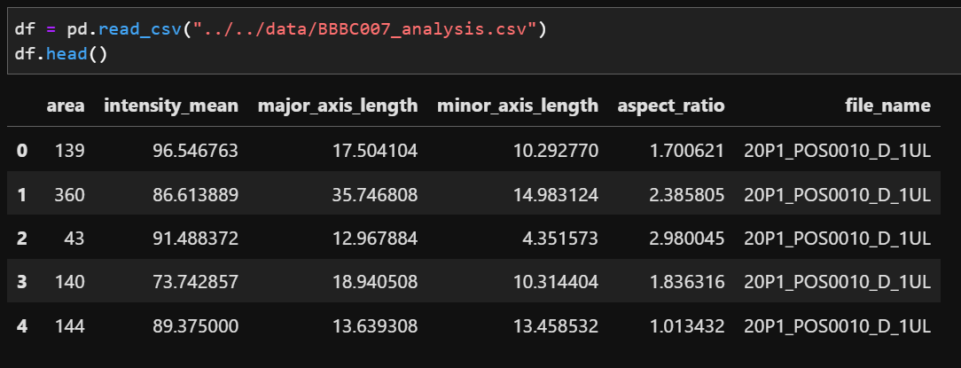
Plotting Data with Seaborn
Plotting tabular data: scatterplots

Slide 10
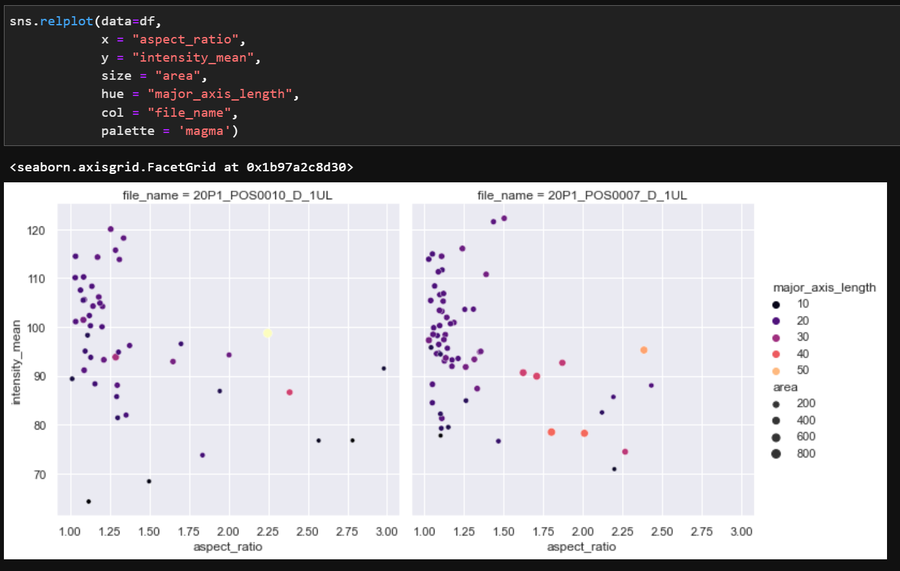
Plotting Data with Seaborn
Plotting categorical variables splitted:

Slide 11
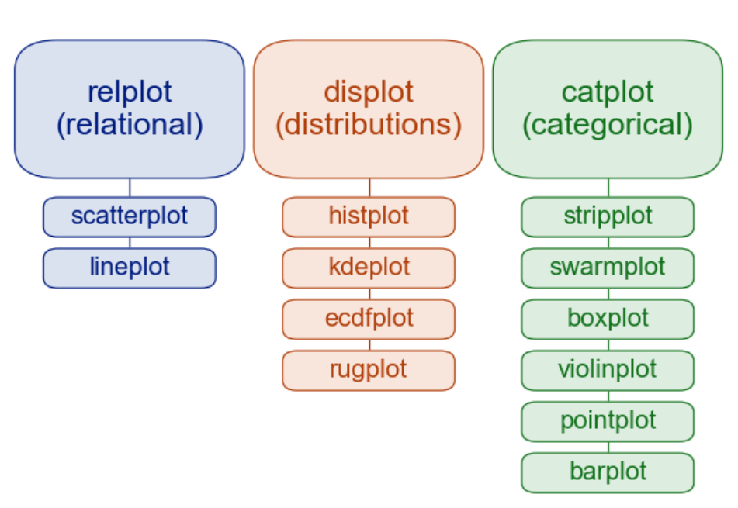
Plotting Data with Seaborn
Figure-level functions vs axes-level functions
Figure-level
Axes-level

Slide 12
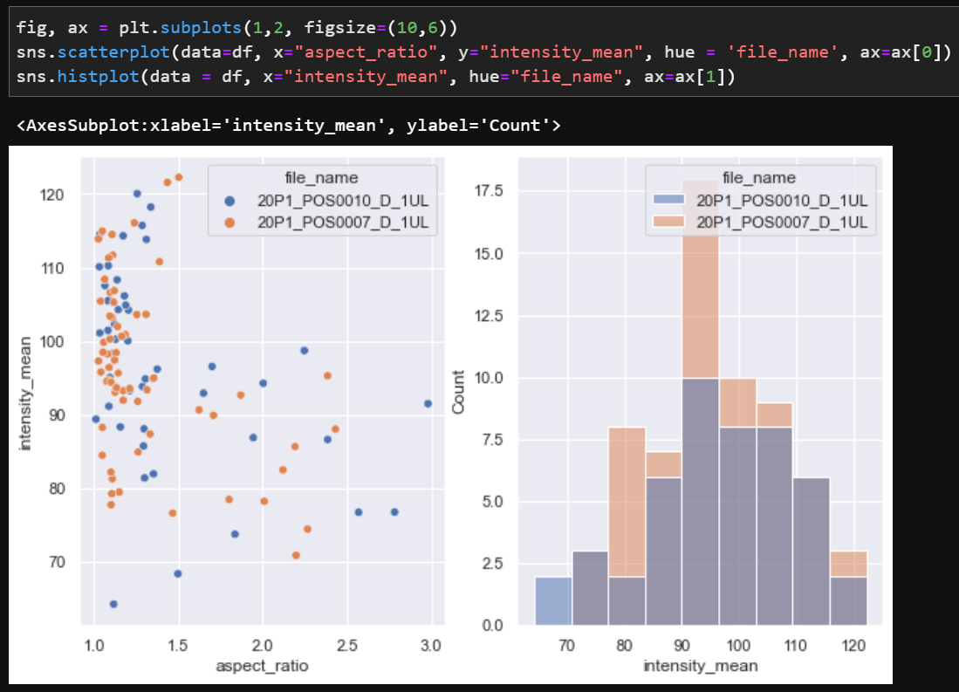
Plotting Data with Seaborn
Figure-level functions vs axes-level functions

Slide 13
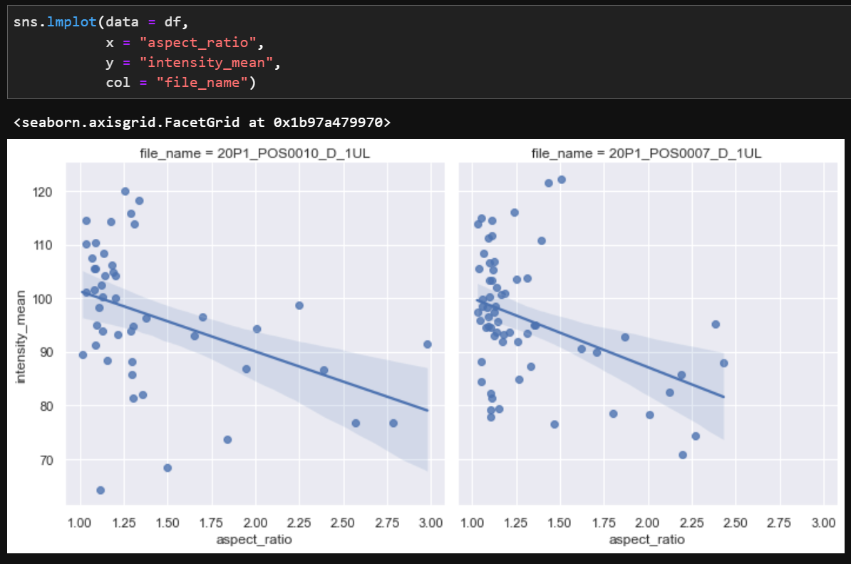
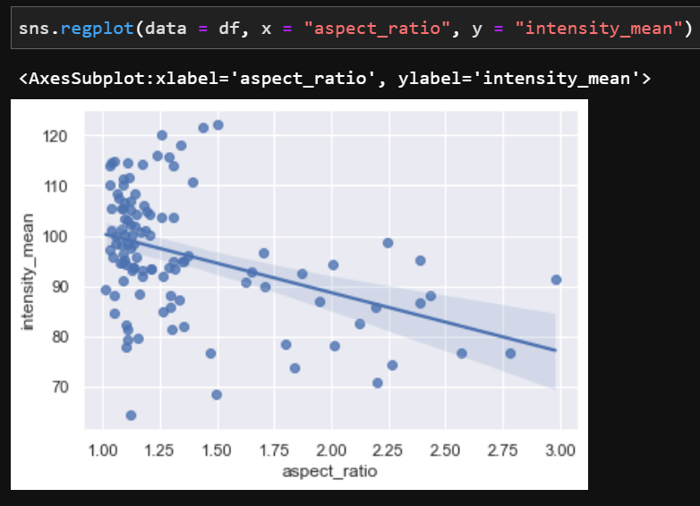
Plotting Data with Seaborn
Adding a line regression to a scatter plot
Axes-level
Figure-level

Slide 14
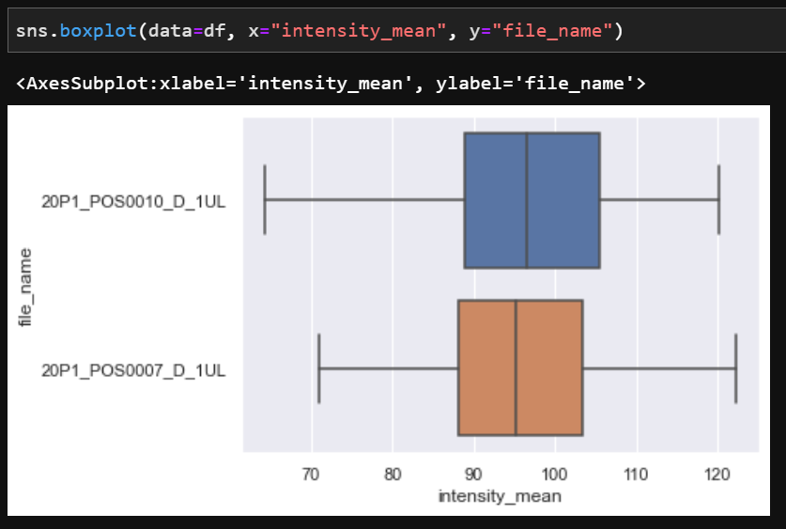
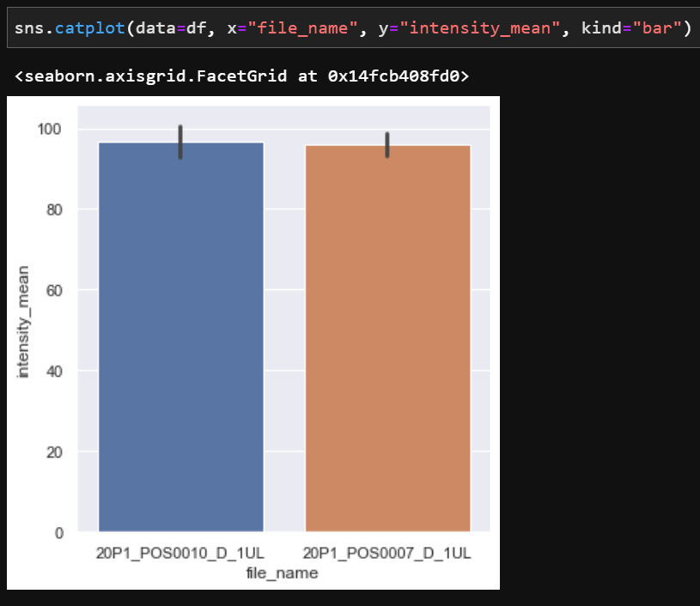
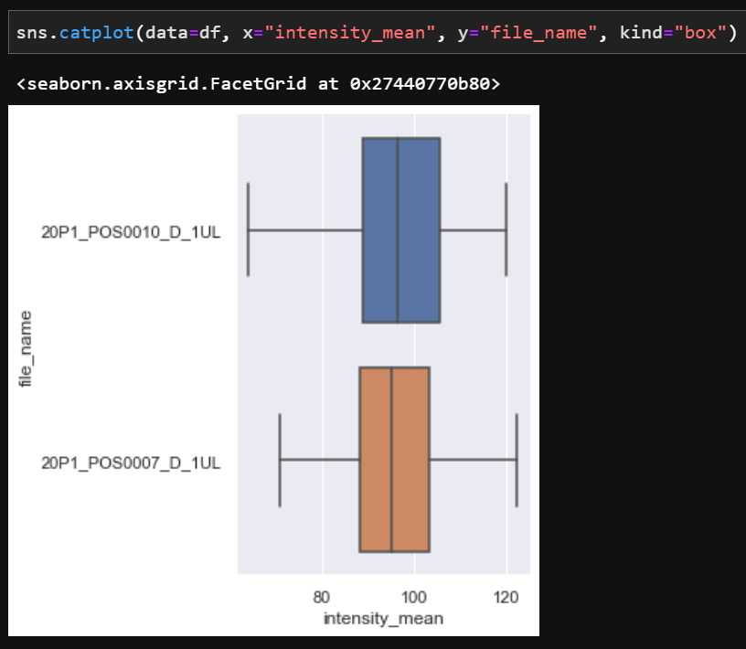
Plotting Data with Seaborn
Boxplots
Axes-level
Figure-level

Slide 15
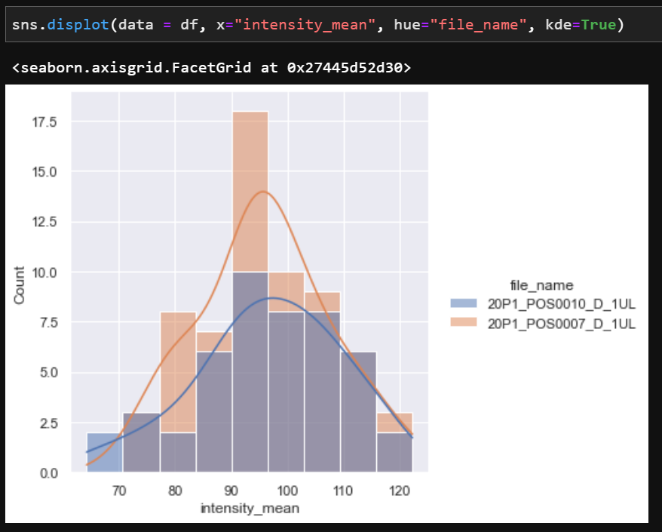
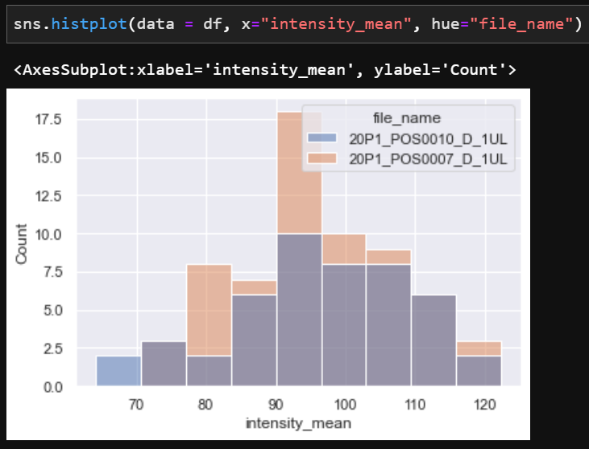
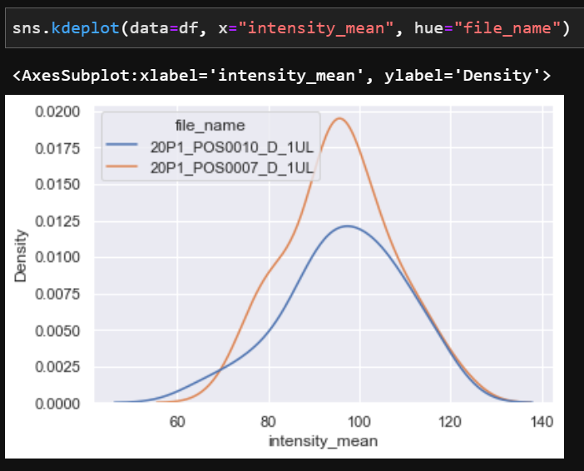
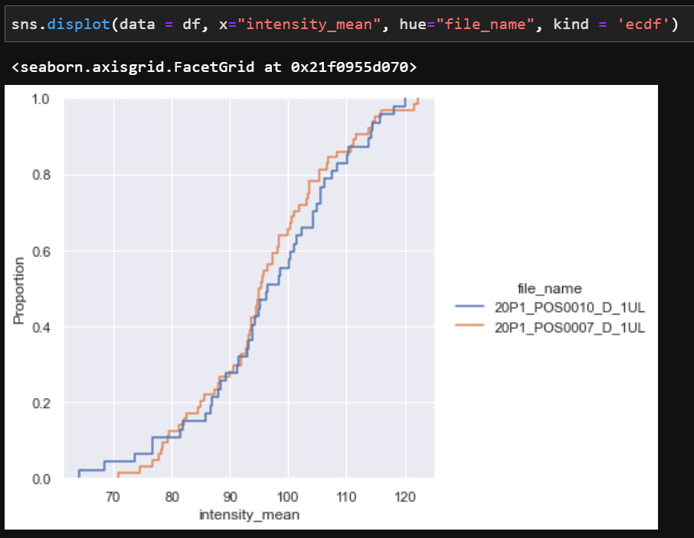
Plotting Data with Seaborn
Histograms
Axes-level
Figure-level

Slide 16
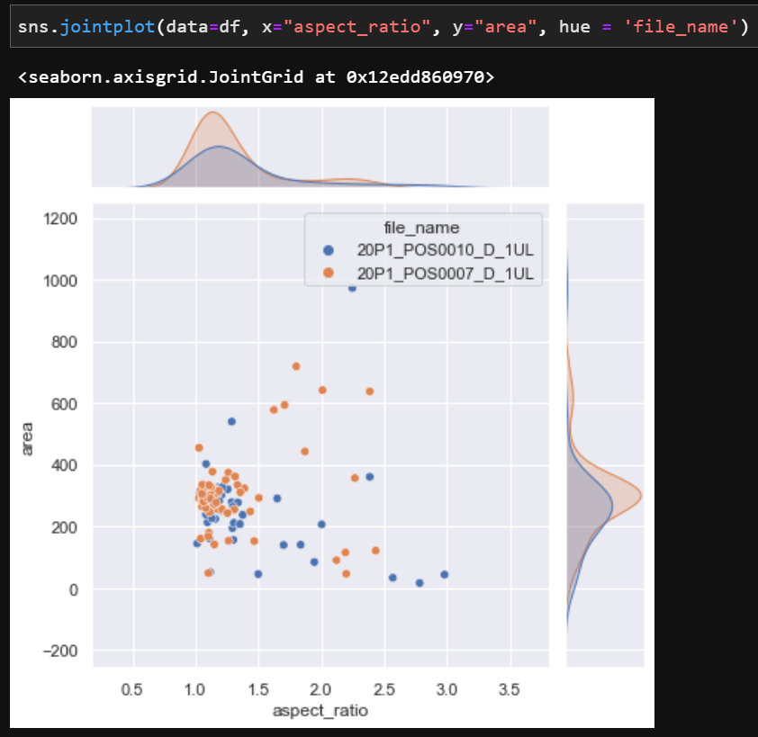
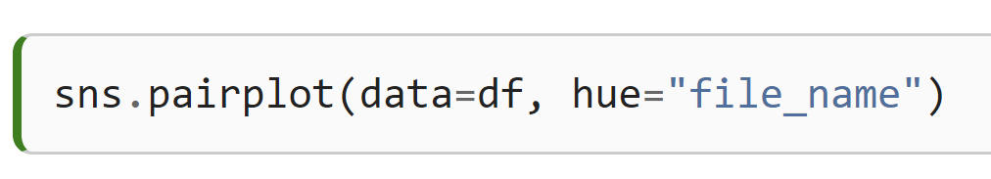
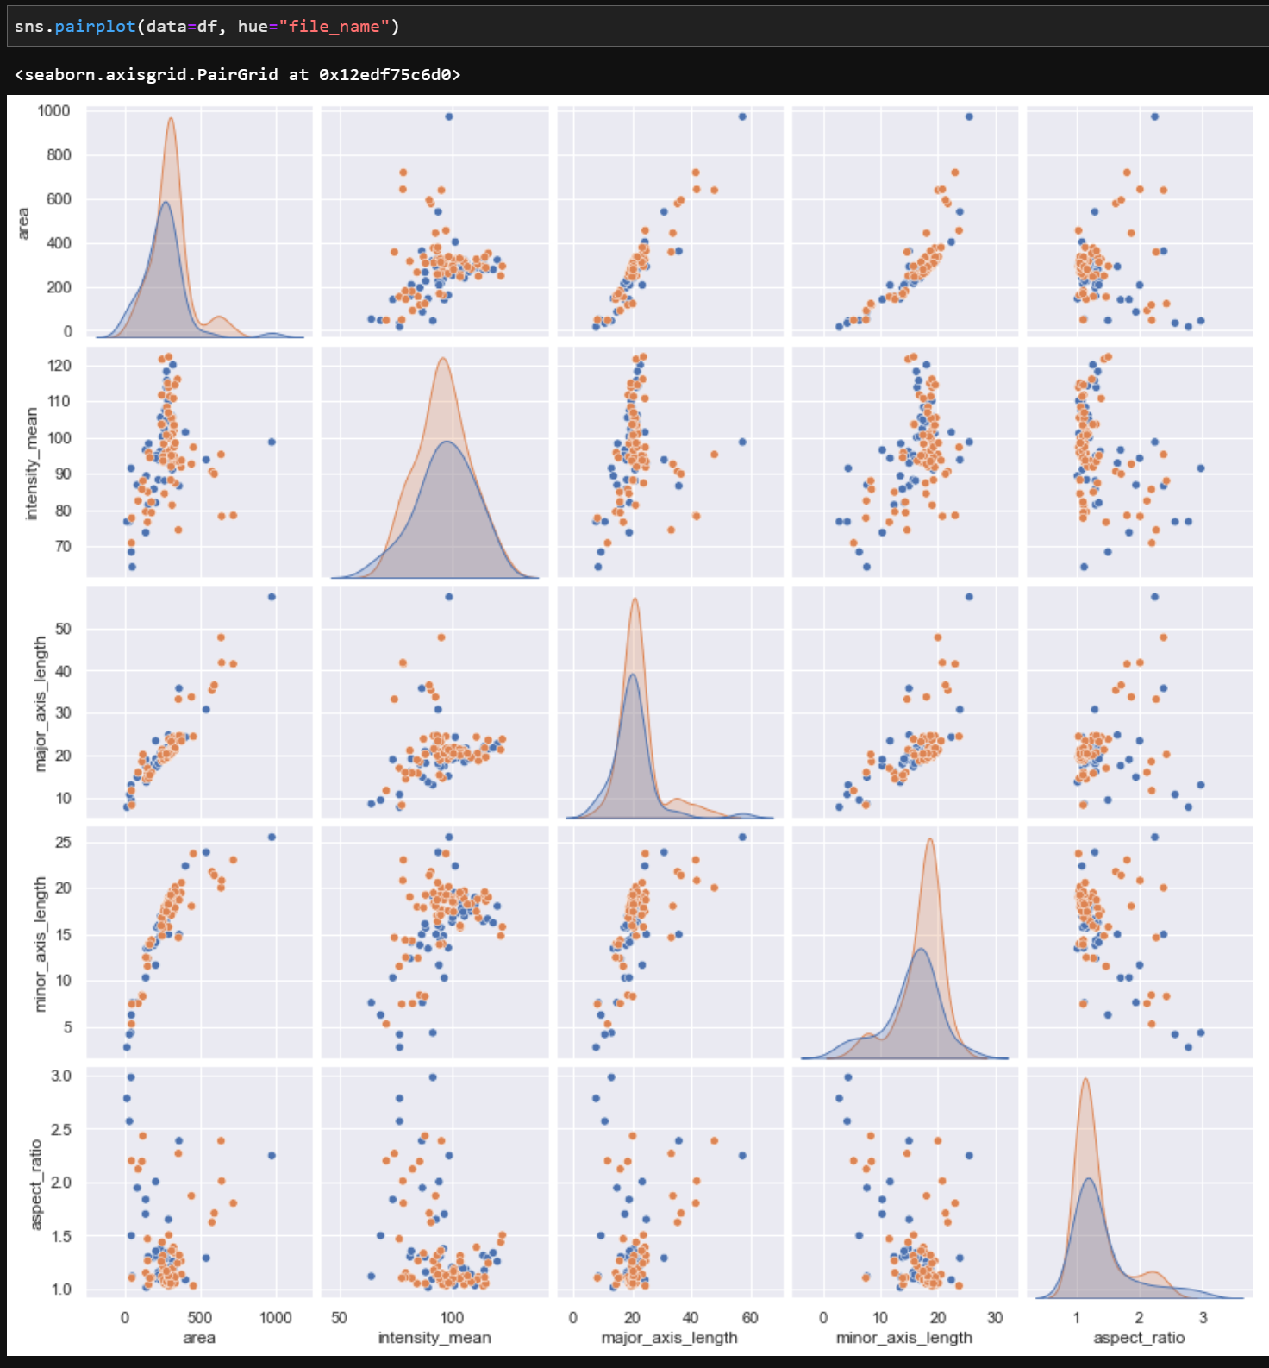
Plotting Data with Seaborn
Joint distributions and pair-plotting multiple properties
Figure-level
Figure-level

Slide 17
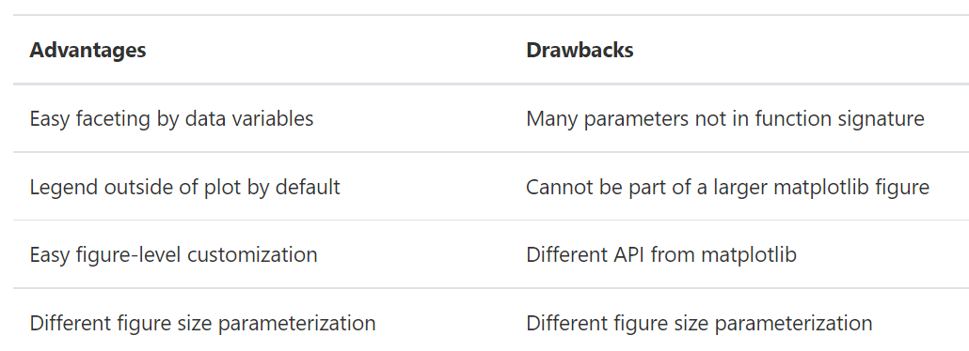
Plotting Data with Seaborn
Pros and cons of Figure-level functions:

